Slide 1



Git/Github Workshop
Feb. 28, 2020
Thank Jasleen Grewal for her slides
Photo credit: http://molonc.bccrc.ca/
Amirhossein Afshinfard
Ph.D. student, Bioinformatics Graduate Program, UBC
Prof. Inanc Birol Lab (BTL), Genome Sciences Centre, BC Cancer

Slide 2
Pre-workshop
https://github.com/afshinfard/github_workshop
1
/19

Slide 3
Outline
Introduction
Introduction
Proposed method
Results
2
/25

Slide 4
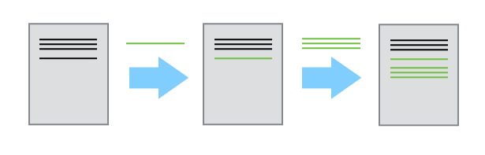
Introduction
Problem:
Thesis.doc
Thesis.doc
Thesis.doc
Current Solution:
Thesis.doc
Thesis_final.doc
Thesis_final2.doc
3
/19

Slide 5
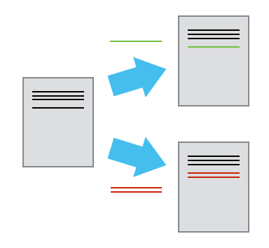
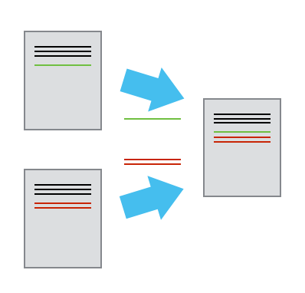
Introduction
Git solution:
Thesis.doc
Thesis.doc
Thesis.doc
3
/19

Slide 6
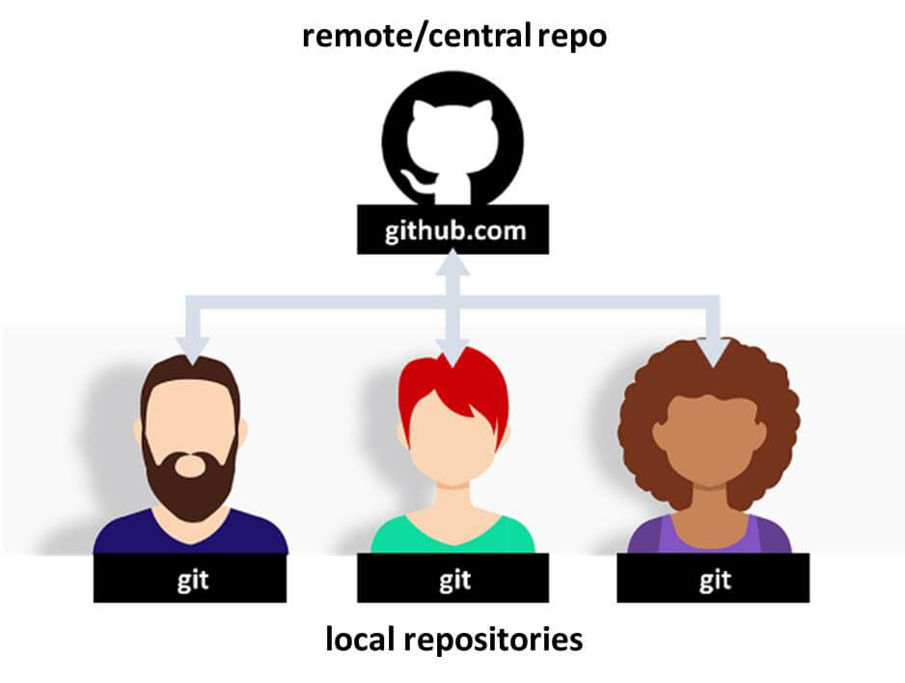
Introduction
Git solution:
3
/19

Slide 7
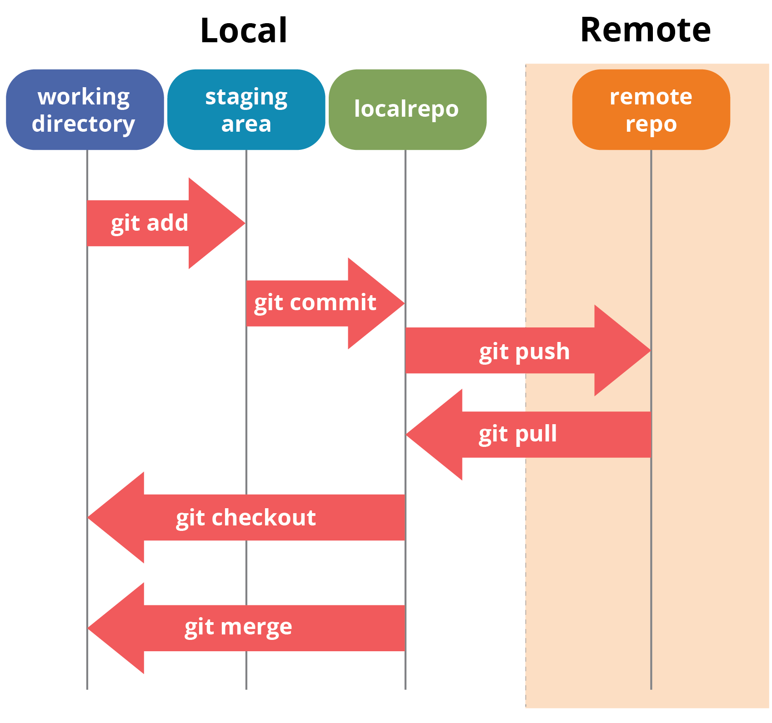
Introduction
index
head
3
/19

